Slide 1
Health Monitoring Application
UC Berkeley Extension Data Analytics BootCamp
Project 2
Alina Smirnova, Anna Burlyaeva, Himani Singh, Lucila Rondissone

Slide 2

Idea
Creating a tool to log, monitor and visualize various indicators about specific health conditions
Notes:
I’m pretty sure that almost everyone faced the situation when you or someone close to you needs to monitor some specific health indicator. For example, blood pressure, frequency of headaches or just weight. But you don’t have enough time or just don’t want to write down all these things. But it’s really important for your doctor, because this information let him to diagnose accurately. That’s why it would be great to have a tool that you can use to keep and visualize your information to take a control of your health conditions.

Slide 3
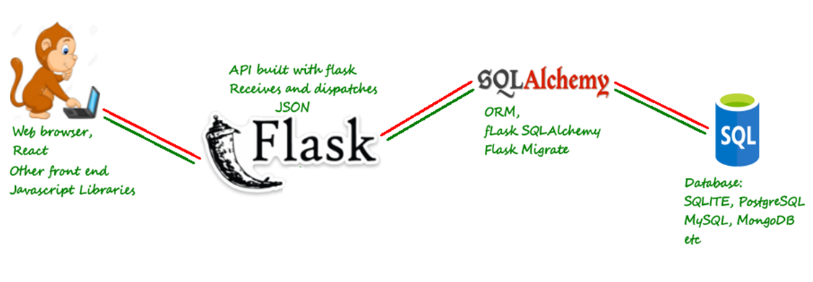
Architecture
Part 3: Fetch data from API
Part 1: Save info to MySQL DB
Part 2: Deployment
Flask + DB
Part 4: React.js + Material-UI

Slide 4

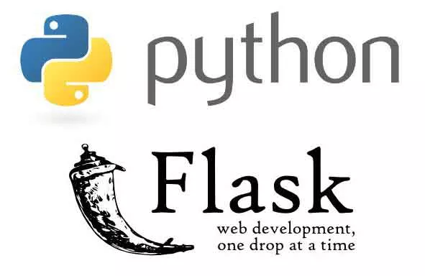

Back-end: MySQL + SQLAlchemy + Flask

Slide 5

Front-end: React.js + MaterialUI

Slide 6

Conclusion
Team work is a real pain, but it’s worth it ☺

Slide 7
Q&A
Thank you for your attention, we are ready to answer your questions

